Slide 1
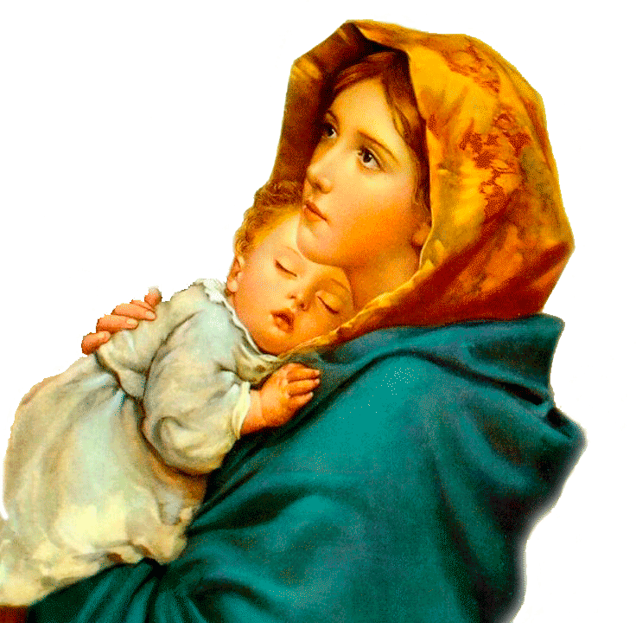
JORDÁNY MARIA

